Slide 1
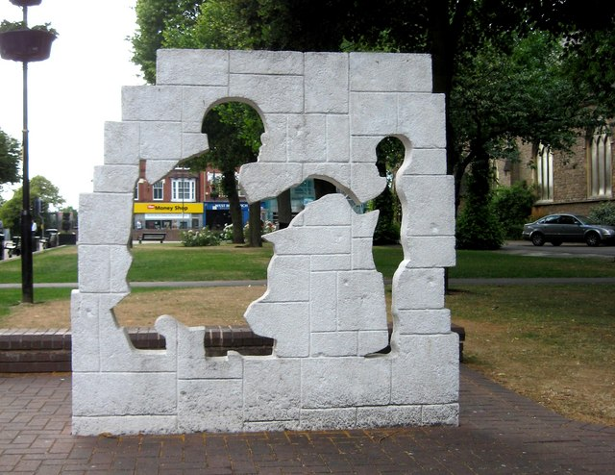
Make it meaningful: Transforming the TCRWP Research Unit
Teaching the Holocaust
Josh Bicknell
ELA 8

Slide 2
What's the problem?
The "Essential Research Skills for Teens" unit by Lucy Calkins requires a major overhaul. Our students also deserve an introduction to the important topic of the Holocaust while simultaneously teaching them the critical skills of research synthesis, understanding bias, identifying sources, and more.
Furthermore, the TCRWP Units of Study does not align with the science of reading (per Texas law), and lacks standards alignment and suggestions for differentiated instruction, including for Special Ed and ESL students.

Slide 3

What's the Solution?
It is still possible to follow district and campus expectations, utilizing the Units of Study writing workshop framework and following similar lessons as required, teaching the same skills, at the same time, including by "Bends."
We do this by replacing the content with the content (age-appropriate Holocaust and human rights study) and using TEKS to align standards to the Units of Study curriculum which otherwise does not include these. Finally, we include ELPS for ESL students and differentiated activities and assessments to appropriately scaffold the subject to all students.

Slide 4
Goals/overview
Replace
Confidently replace content from the TCRWP unit with curated research materials donated by Holocaust Museum Houston (and optional Padlet.)
Align
Align standartds (TEKS) to the TCRWP Units of Study.
Adjust
Adjust formative and summative assessments to fit the individual needs of students
Understand
Understand how to approach a sensitive subject like the Holocaust
Prep
Be prepared to teach essential research with content that matters and is more meaningful!
At the end of this presentation, you will be able to:

Slide 5

Preparing to teach

Slide 6
What will you need
You will need the following:
  Original TCRWP spiral, "Essential Research for Teens"
  Padlet Links (Bookmarked) for Bends 1, 2, and 3 (Research Articles, Interactive Map, and “The Hangman” Padlet)
  Presentation slides (optional) that follow sessions day-by-day
  Holocaust Remembrance Toolkit from HMH (Packets sent by email and shared on Google Drive)
  Holocaust Museum Houston's Digital Trunks with iPads – 1 per teacher, 30 per class
  Copy of TEKS (Informational and Research)

Slide 7
BUT FIRST...
Above all, you need …

Slide 8
A COMPREHENSIVE UNDERSTANDING OF THE HOLOCAUST, and how to teach it.
Do This, Not That
Historical Accuracy
There are some things to consider when teaching the Holocaust. Although we will be following the strict sessions (somewhat) of TCRWP as required, try to remember these general guidelines:
  Avoid simplification. (Kids will ask tough questions - avoid the temptation to simplify your answers by using broad generalizations and moral simplifications. This is not a unit on “bullying” or simply “being an upstander.” While admirable, this is insufficient.)
  Do NOT use simulations or make superficial comparisons (i.e. "Imagine if the principal took away all your rights!" Or "Imagine if the President declared all kids to be sent to boot camps!") - Comparisons in general are highly inappropriate and can lead to trivialization, minimization, and Holocaust distortion.
  Monitor student research CLOSELY. It is best to use curated materials that are already approved. Students should not be exposed to potentially antisemitic content, Holocaust distortion, or sources that minimize or incorrectly contextualize the Holocaust. The unit will teach students to critically analyze sources, but until they arrive there, they need our guidance.
  Show humanity, not shock value. Each picture has its place. Be mindful of the types of images you choose to show. Showing family photos from before and after the war, for example, can be more powerful for students when humanizing the "6 million."
This is a powerful unit that most, if not all, students will be encountering for the first time. Teaching with historical accuracy is non-negotiable. If in doubt, always ask.
  Be able to DEFINE: What is the Holocaust? (Avoid the “11 million” confusion. To simplify: The Holocaust was the systematic, state-sponsored persecution and murder of 6 million Jews by the Nazi regime, its allies, and collaborators.) -> Break each term down for students. What does “systematic” really mean? What does it mean to be ”state-sponsored”?
  Understand the context of the Holocaust. (i.e. You must learn some European history, political ideologies, the Jewish experience and identity, and the crime of genocide, to name a few.) Additionally, spend time focusing on Jewish life BEFORE the Holocaust. The human element is the most critical of all.
  Read through the Holocaust Remembrance Toolkit for a thorough understanding of the subject. Test yourself and when in doubt, ask again.

Slide 9

TRANSFORMING THE WRITING WORKSHOP

Slide 10
LET'S TALK BENDS.
TCRWP BENDS: REVISED BENDS:
The provided Units of Study is separated into 3 "Bends," each with a summative assessment at its conclusion, and each made up of relevant “sessions.”
The following table showcases how we will transform these bends from superficial subject matter to meaningful content. *REMEMBER:
  It is often a district requirement to follow the curriculum timing of Bends and Sessions EXACTLY.
  Follow your calendar and if you fall behind, ask for help. Do not skip.
  The "WHAT" (skills)/standards) we teach is non-negotiable, the "HOW" should be, though (specific content/materials, pedagogical approach)
  We will do this by examining the Holocaust and human rights from the PAST (Bend 1), the PRESENT (Bend 2), and the FUTURE (Bend 3).
Bend II: Ethical Research Practices and Internet Literacy | Bend II: Complexity and Synthesis - Then and Now (Focus on THE PRESENT)
Bend III: From Research to Activism | Bend III: From Darkness, Light: Building the Future (Focus on THE FUTURE)
Bend I: Essential Study Habits - Building Background Knowledge, Taking Lean Notes, and Becoming an Effective Study Partner
Bend I: Introduction to Research - The Holocaust & Human Rights (Focus on THE PAST)

Slide 11

Bend I: the past
Bend I in the TCRWP consists of students choosing whether to research chocolate milk and milk choices in schools, or extracurricular activities and clubs in schools. This leaves little room for critical thought and leaves students unprepared for the complex research skills needed in high school and beyond. Additionally, this has replaced an entire Savvas unit in most cases which introduced students to the Holocaust and media literacy.
In the revised sessions, students focus less on "just moving forward" as required in the Units of Study, and more on careful exploration and understanding of the topics of Holocaust and genocide. However, the same skills are taught, with adjusted focus on research and informational texts. Student focus is on researching the past – that is, the fundamentals of the Holocaust and selecting an area of focus within this complex topic.

Slide 12

Transforming sessions within the bends.
Using your TCRWP spiral and the "Essential Research Skills for Teens" unit, brainstorm how you might utilize the same skills outlined in each session (lesson) but with the material/content related to the Holocaust.

Slide 13
DISCUSS & RE-GROUP
What challenges did you face when brainstorming this transformation?
What opportunities do you see for improvement?
What are some predictions you can make about student misunderstandings?
What gaps do you have in your own knowledge of the Holocaust and human rights that would be necessary to explore before teaching?

Slide 14
BEND I SESSIONS, REVISED (Example)
TCRWP SESSIONS: REVISED SESSIONS: Notes:
Session Zero – Forming Research Clubs and Choosing Research Topics | Session Zero - Explicit Instruction: Defining the Holocaust, Historical Context, Note-Taking Strategies | Students should not be choosing research topics yet, until they have at least a general understanding of the topic, its context, and its definitions.
Session 1: Read-Aloud: Discerning Explicit and Implicit Ideas in Complex Nonfiction | Session 1: Read-Aloud: Discerning Explicit and Implicit Ideas in Newspaper Articles (Historical Lens); Making Complex Inferences through Close Reading | Original Read-Aloud: Student’s Interest in Milk/Chocolate Milk Nutrition Revised Read-Aloud: Article from New York Times (May 12, 1933) - "Hitler Power Seen in Middle Class" - Create T-chart with implicit and explicit details; making inferences
*IMPORTANT: TEKS ALIGNMENT.
Go through your WAG and YAG Standards for Informational/Research TEKS. How do they align with the skills taught in each session? For example: Session 1 covers implicit and explicit details. We chose a newspaper article instead of a chocolate milk fact sheet. Highlight VERBS. What are the kids expected to DO? (In Session 1, consider 8.23 and 8.24)

Slide 15
Practice activity: HOW MANY BARS?
Getting a sense of student understanding, misunderstanding, and engagement is critical for this unit.
There are multiple resources in the Holocaust Remembrance Toolkit as well as resources from Facing History & Ourselves and Echoes & Reflections. (Additionally, students will spend time exploring testimony related to their research topic through the USC Shoah Foundation.)
To demonstrate how to use a strategy (we’ll use FHAO in this case) in the classroom, let's practice one now.
Follow the guidelines on the "How Many Bars?" Handout to demonstrate your level of understanding up to this point, and how well prepared you feel in implementing this similar practice for the remaining 3 bends.

Slide 16
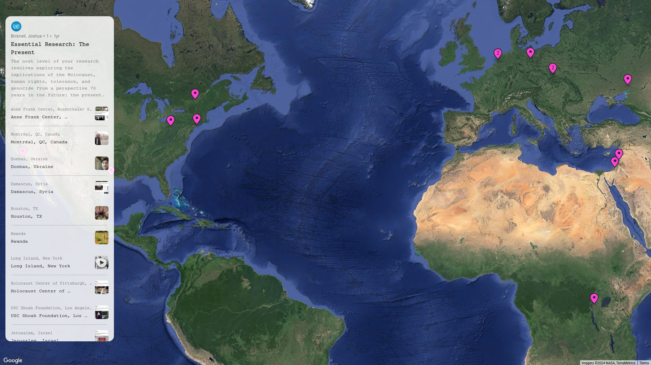
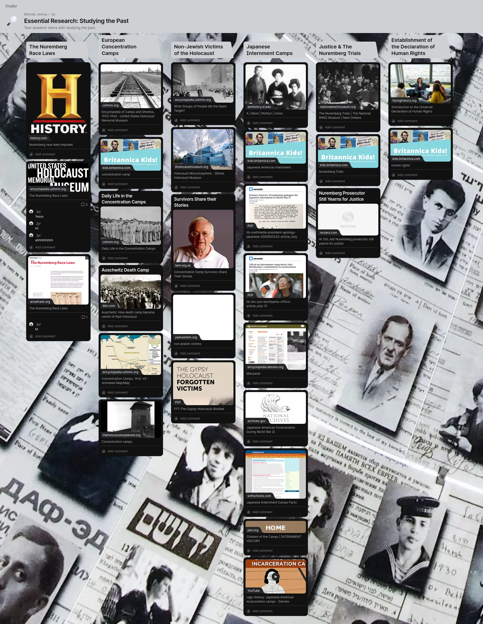
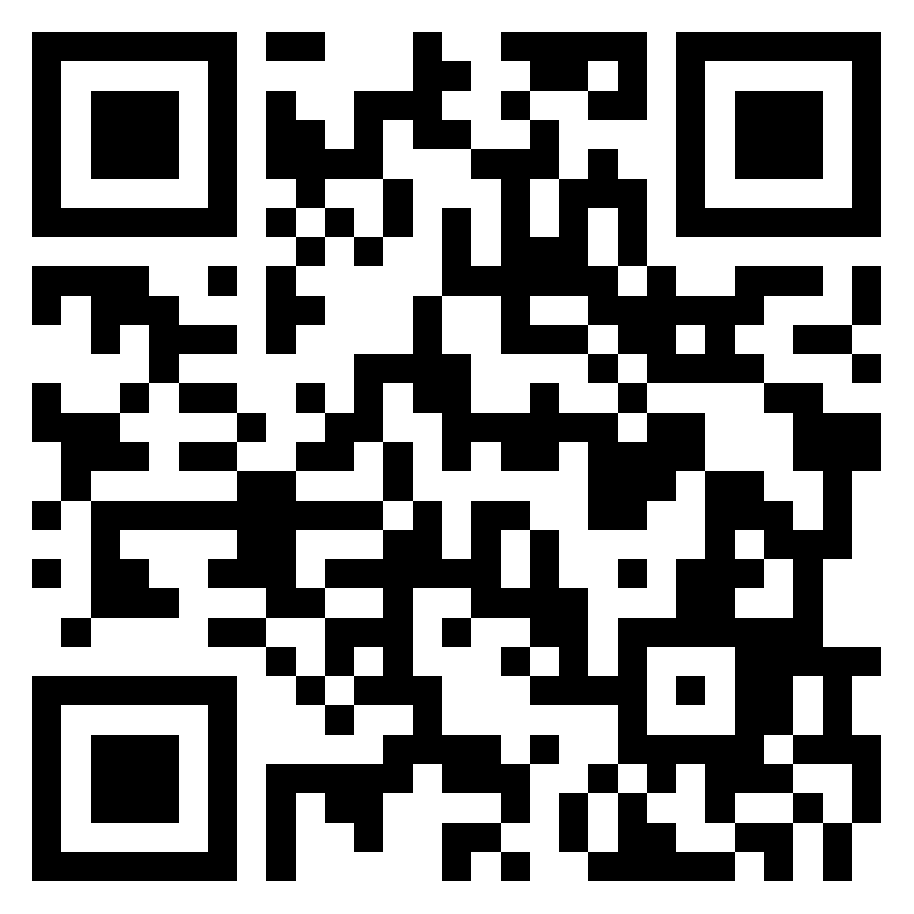
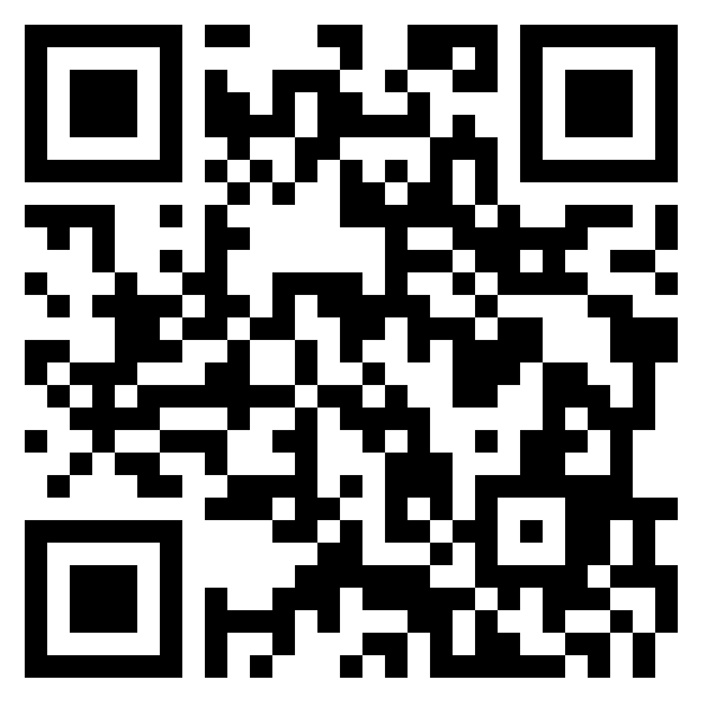
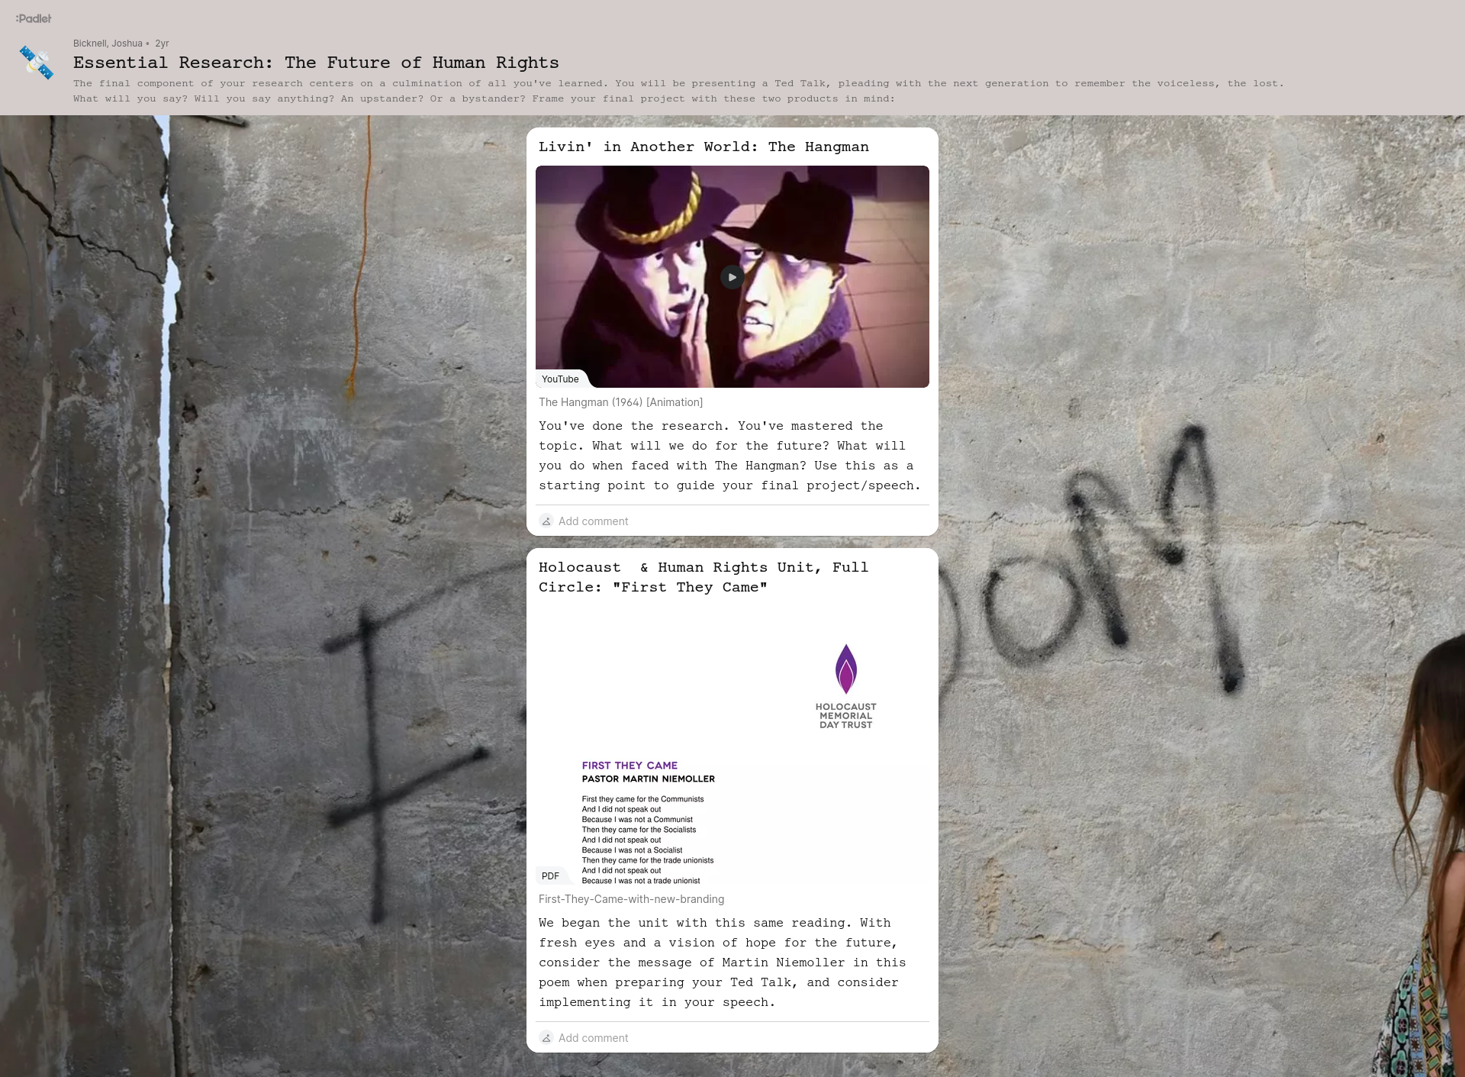
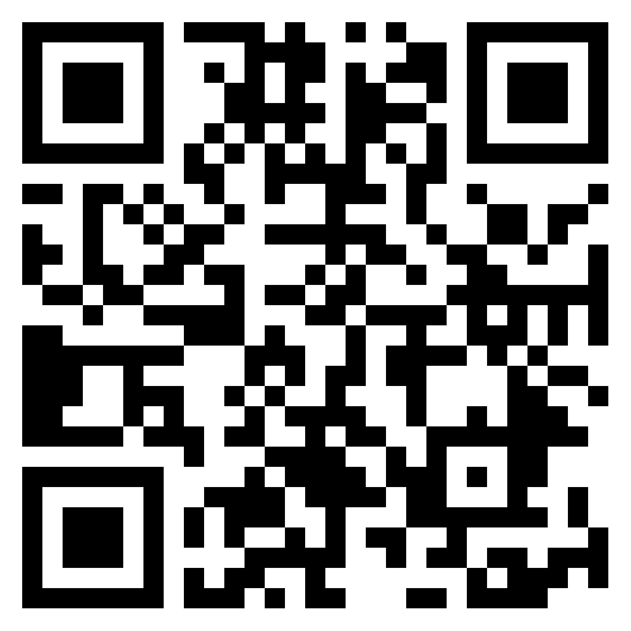
Same bends, different subject:
Instead of the Padlets used for chocolate milk vs regular milk and school clubs, utilize curated articles from the Holocaust digital trunks donated by Holocaust Museum Houston. Utilize the same Padlet format for the other content as students narrow their research topics. Here are the links to use:
Bend 2: The Present
Bend 1: The Past
Bend 3: The Future

Slide 17
Practice activity: creating content
Now that we've walked through the transformation of a "bend" and a couple of sessions within that bend, try brainstorming how this same process can be implemented with the remaining bends. Remember to utilize the Padlets of the Past, Present, and Future for inspiration.
Additionally, the next slide will showcase the assessments to be completed at the end of each "bend." Remember that these must be UNIVERSAL and are non-negotiable, using the SAME rubrics as the original TCRWP unit. We are only adjusting the CONTENT.
Don't forget to align with TEKS! Highlight verbs, look at your vertical alignment.

Slide 18
Formative and summative assessments
*Assessments are non-negotiable in terms of the type of assessment given and the rubric used. However, what is negotiable is the level of rigor expected and the content covered. Here is how each bend will end with an altered focus on the same assessment style:
ASSESSMENT | TCRWP FOCUS | REVISED FOCUS
BEND I: INFOGRAPHIC | Charts, graphs, nutrition facts on milk vs. Chocolate milk or clubs in schools | Statistics, evidence of primary and secondary sources, sensitive use of images, demonstration of pre-war and post-war life
BEND II: FLASH DEBATE | Students debate on their chosen topic in front of the class about which is better (milk, chocolate milk, clubs, etc.) | Students explore highly complex ethical issues related to the Holocaust within their same research area (i.e. Should Anne Frank's diary have been published? Incompletely? Completely?) - Then students debate accordingly
BEND III: TED TALK | Students synthesize their research and present a Ted Talk about nutrition, school club sponsorship, etc. in video or live format. | Students continue to synthesize what they've learned, formulate essential questions, and present a Ted Talk style speech about how to promote tolerance, identify and counter antisemitism, and work toward genocide prevention in the future, using the lessons of the Holocaust to support their claims.

Slide 19
THANK YOU
Josh Bicknell
281-245-7801
Joshua.Bicknell@springbranchisd.com
Josh-bicknell@outlook.com

